Slide 1
EVOLUTION OF
STEGANOGRAPHY
Ancient methods • modern media • practical LSB coding • steganalysis
SOURCE-BASED DECK
Based on the uploaded article “Ancient and Modern Steganography”
Prepared by : SOMU R 2025541061

Slide 2
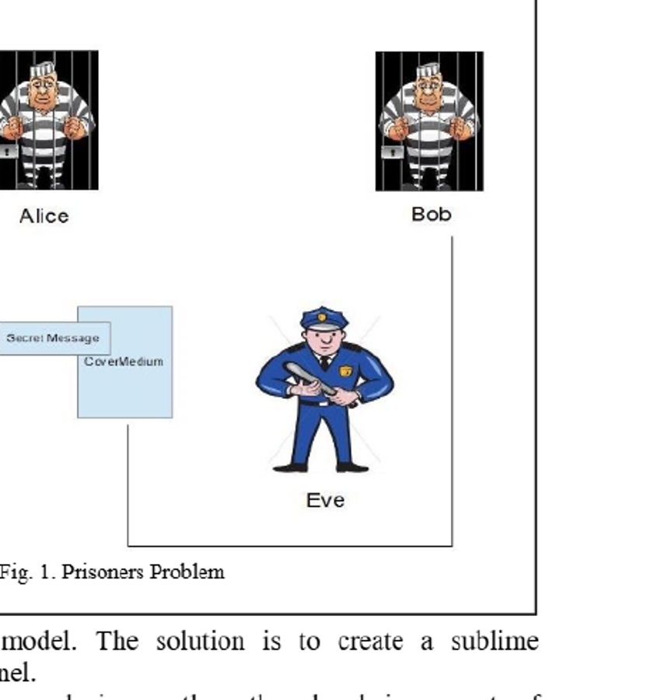
01 • FOUNDATION
What is steganography?
“
“Putting information in a medium without causing significant and statistically difference in the medium.”
The article frames steganography as “cover writing” - information is concealed so it can pass from sender to receiver without attracting notice.
Its central idea is concealment, while cryptography primarily transforms information into an unreadable form.
The sender creates a “sublime channel” so the communication medium itself does not look suspicious.
PRISONERS’ PROBLEM
Alice sends to Bob through a guarded channel; the communication must blend into a normal medium.
Source: Saugata Dutta & Dr. Om Prakash, “Ancient and Modern Steganography”, Asian Journal of Convergence in Technology, Vol. II, Issue III.

Slide 3
02 • CONCEPT CHECK
Steganography vs. cryptography
STEGANOGRAPHY
CRYPTOGRAPHY
Goal
Hide the existence of the message
Goal
Protect message meaning by transformation
Cover medium remains usable after embedding.
Detection is the key challenge: can an observer tell something is hidden?
Often combined with encryption for added security.
Ciphertext is intentionally apparent as transformed data.
Security depends on the cryptographic construction/key.
The article explicitly warns not to confuse the two.
Source: Saugata Dutta & Dr. Om Prakash, “Ancient and Modern Steganography”, Asian Journal of Convergence in Technology, Vol. II, Issue III.

Slide 4
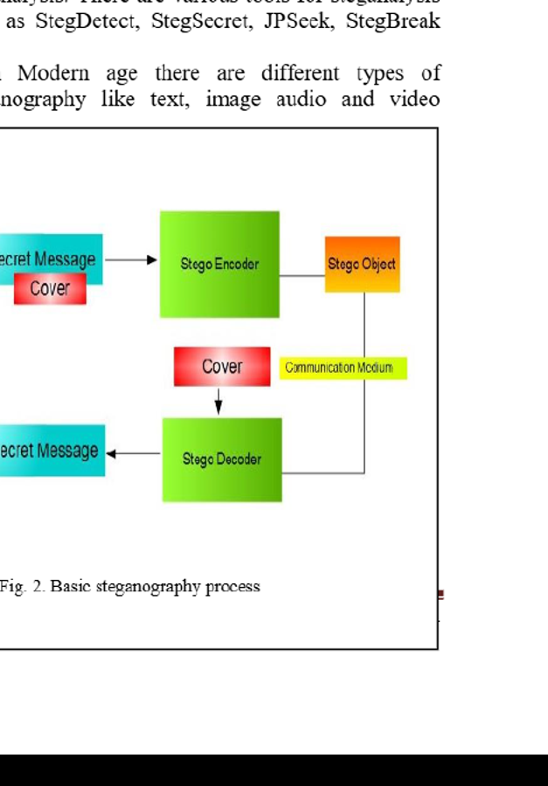
03 • ARCHITECTURE
Basic steganography process
1
Secret message
payload
2
Cover medium
image / text / audio / video / protocol
3
Stego encoder
embedding function
4
Stego object
normal-looking carrier
5
Decoder
extract hidden message
Source: Saugata Dutta & Dr. Om Prakash, “Ancient and Modern Steganography”, Asian Journal of Convergence in Technology, Vol. II, Issue III.

Slide 5
04 • EVOLUTION
From ancient concealment to digital carriers
The article’s central message: the medium and technique change over time, but the concealment objective remains.
1
2
3
4
5
Ancient
Classical
WWII era
Digital image
Multimedia
wax tablets • body vectors • geoglyphs
Cardan grille • text hiding
microdots • sign language • quilts
LSB • PVD • transform domain
image • text • audio • video • protocol
Source: Saugata Dutta & Dr. Om Prakash, “Ancient and Modern Steganography”, Asian Journal of Convergence in Technology, Vol. II, Issue III.

Slide 6
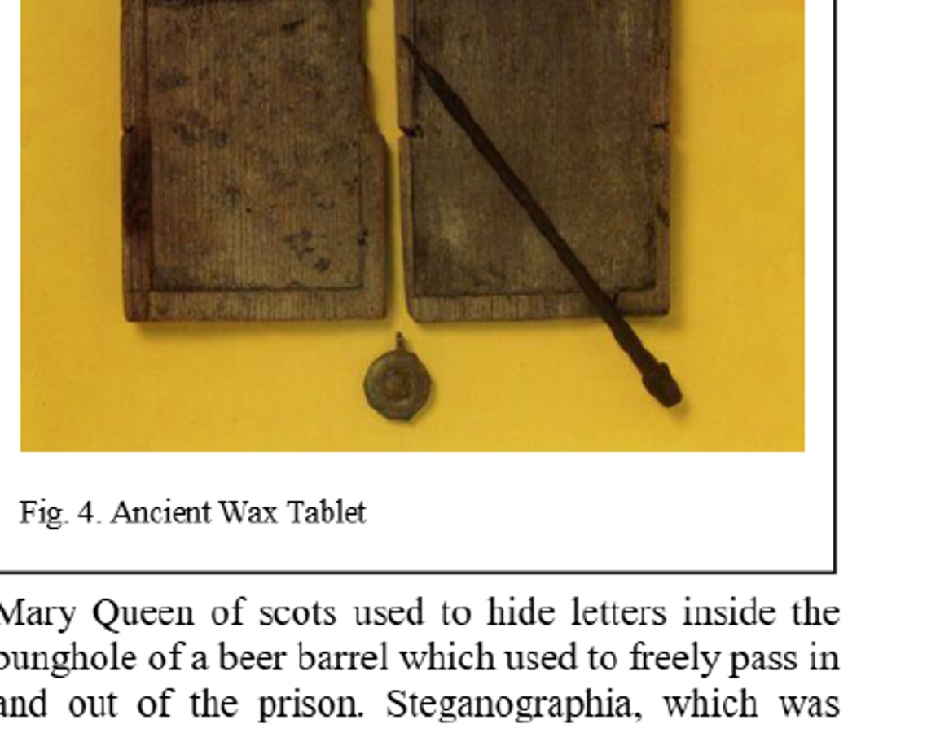
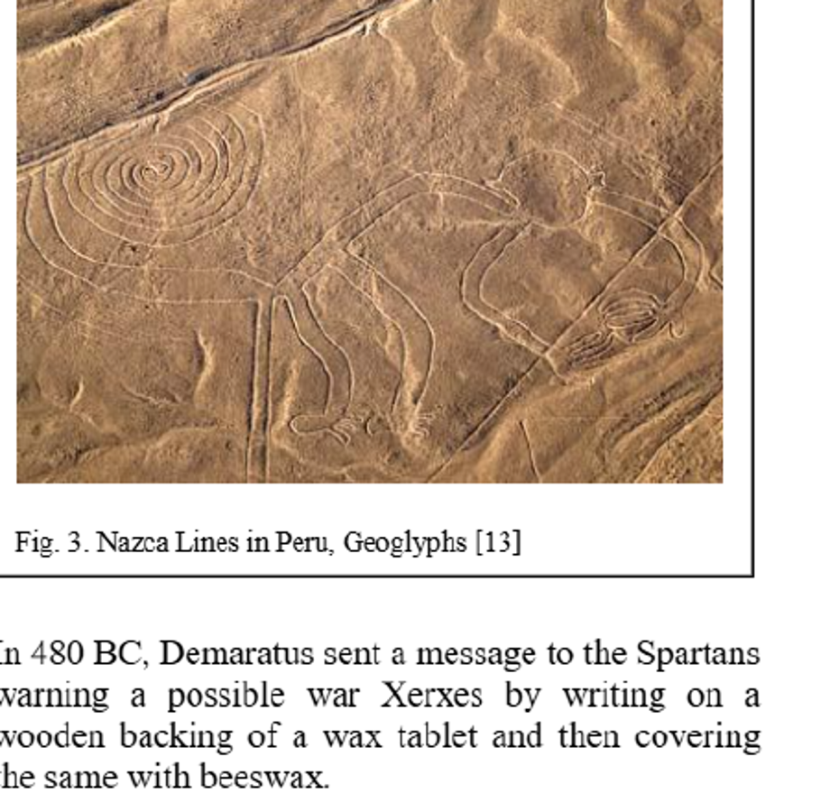
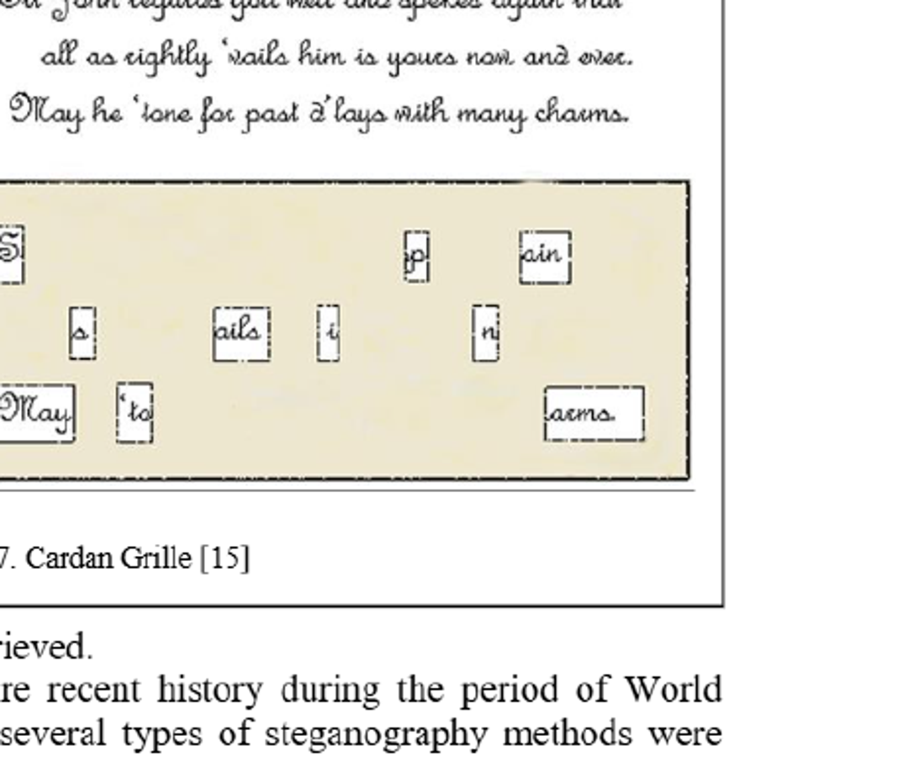
05 • HISTORY
Ancient steganography: hiding in plain sight
WAX TABLET
GEOGLYPHS
CARDAN GRILLE
Demaratus wrote on the wood backing of a wax tablet and covered it with beeswax.
The article cites the Nazca Lines, Uffington White Horse, Cerne Abbas Giant and other figures visible from the air as examples of large-scale hidden communication.
Cardan Grille uses a prepared grid with apertures; the message is written through the holes and then disguised by ordinary-looking text.
Source: Saugata Dutta & Dr. Om Prakash, “Ancient and Modern Steganography”, Asian Journal of Convergence in Technology, Vol. II, Issue III.

Slide 7
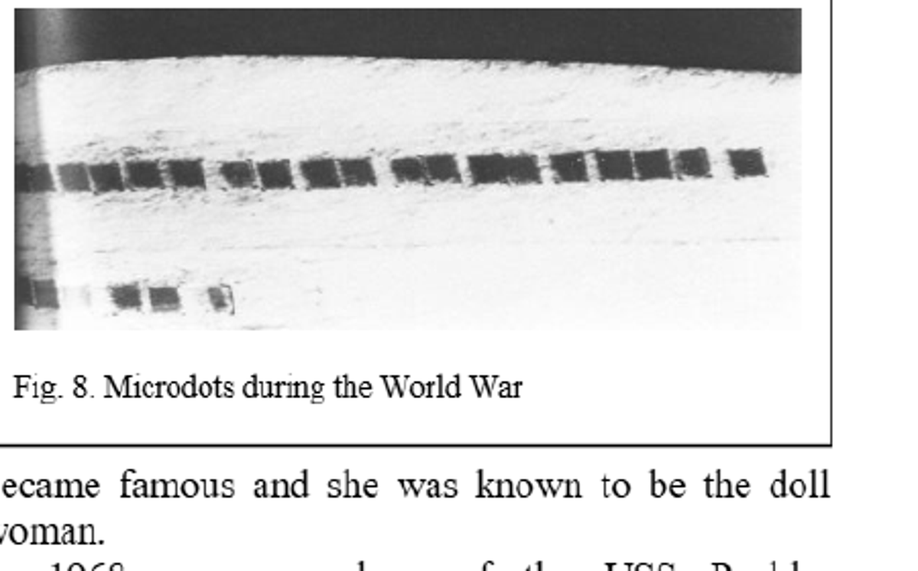
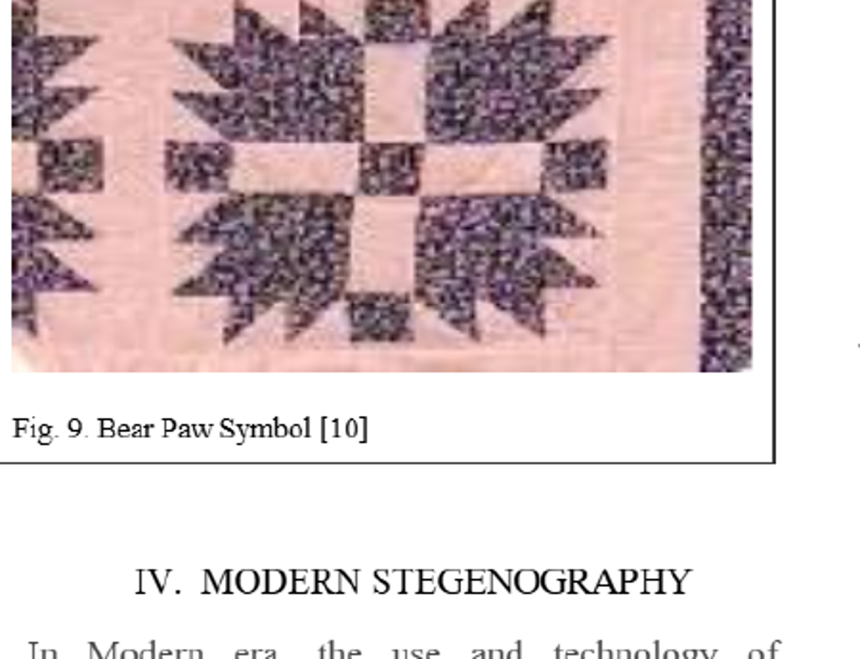
06 • EXAMPLES
WWII and historic practical vectors
MICRODOTS
Tiny reproductions could carry pages of information while appearing unremarkable.
BEAR PAW SYMBOL
The article describes quilt patterns as an alleged practical vector for guiding escaped slaves, including the Bear Paw symbol.
LESSON FOR MODERN SYSTEMS
Steganography succeeds when the carrier has a plausible reason to exist. The hiding mechanism should not become the story.
Source: Saugata Dutta & Dr. Om Prakash, “Ancient and Modern Steganography”, Asian Journal of Convergence in Technology, Vol. II, Issue III.

Slide 8
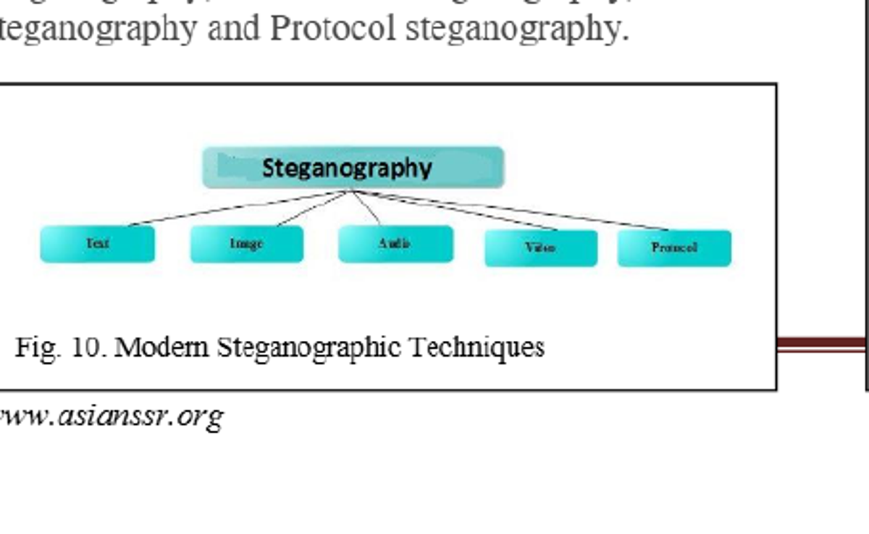
07 • MEDIA TYPES
Modern steganography: the carrier landscape
TEXT
selection • HTML • spaces • shifting
IMAGE
spatial domain • LSB • PVD • transform domain
AUDIO
MP3/WAV • sampling • echo hiding
VIDEO
image + audio techniques across frames
The article explicitly identifies five modern categories: text, image, audio, video and protocol steganography.
PROTOCOL
TCP/IP headers • packet length • VoIP/SIP
Source: Saugata Dutta & Dr. Om Prakash, “Ancient and Modern Steganography”, Asian Journal of Convergence in Technology, Vol. II, Issue III.

Slide 9
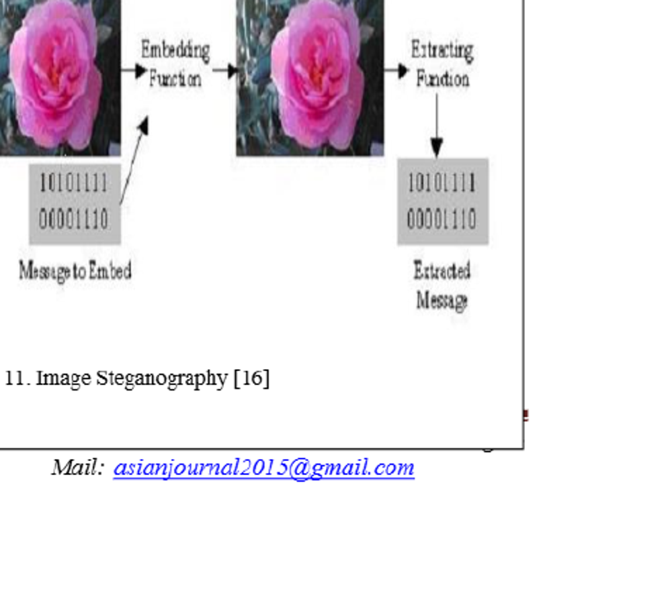
08 • DEEP DIVE
Image steganography and the LSB idea
SOURCE CONCEPT
Hide message bits inside low-order image information so the visual change is difficult to notice.
Common carrier formats cited by the article include JPEG, BMP, GIF and PNG.
A key can be optional; when used, the technique can be combined with cryptography.
Capacity, image quality and detectability become the practical trade-offs.
Source: Saugata Dutta & Dr. Om Prakash, “Ancient and Modern Steganography”, Asian Journal of Convergence in Technology, Vol. II, Issue III.

Slide 10
09 • LIVE CODING
Practical lab: encode a message with Python + Pillow
from PIL import Image
def encode(src, dst, message):
img = Image.open(src).convert("RGB")
bits = ''.join(f"{b:08b}" for b in message.encode()) + "00000000"
px = list(img.getdata())
if len(bits) > len(px):
raise ValueError("message too large")
out = []
for i, (r, g, b) in enumerate(px):
if i < len(bits):
r = (r & 254) | int(bits[i])
out.append((r, g, b))
stego = Image.new("RGB", img.size)
stego.putdata(out)
stego.save(dst)
What the demo changes
Only the least-significant bit of the red channel is touched for successive pixels.
The cover image remains visually usable.
A terminator byte marks the end of the hidden string.
In production, add input validation, a key, and a stronger embedding strategy.
Demo payload
Meet me at 18:30 - bring the demo laptop.
Source: Saugata Dutta & Dr. Om Prakash, “Ancient and Modern Steganography”, Asian Journal of Convergence in Technology, Vol. II, Issue III.

Slide 11



10 • EXPERIMENT OUTPUT
Practical lab result: hide, measure, recover
41
payload bytes
175
pixels changed
84.66 dB
AMPLIFIED DIFFERENCE
demo PSNR
The third image magnifies channel changes; they are not intended to be visible at normal viewing scale.
Decoded message
Meet me at 18:30 - bring the demo laptop.
Source: Saugata Dutta & Dr. Om Prakash, “Ancient and Modern Steganography”, Asian Journal of Convergence in Technology, Vol. II, Issue III.

Slide 12
11 • LIVE CODING
Decode path: recover the hidden message
from PIL import Image
def decode(src):
img = Image.open(src).convert("RGB")
bits = ''.join(str(r & 1) for r, g, b in img.getdata())
raw = bytes(
int(bits[i:i+8], 2)
for i in range(0, len(bits) - 7, 8)
)
return raw.split(b"\x00")[0].decode("utf-8")
print(decode("stego.png"))
What should we evaluate?
Capacity
How much payload can the carrier safely hold?
Imperceptibility
Can a human observer notice the change?
Detectability
Can statistical analysis flag the stego object?
Robustness
Does hidden data survive processing/compression?
Console output
These four criteria are a practical extension for evaluating a demo; the source primarily emphasizes image quality, secrecy and steganalysis.
Meet me at 18:30 - bring the demo laptop.
Source: Saugata Dutta & Dr. Om Prakash, “Ancient and Modern Steganography”, Asian Journal of Convergence in Technology, Vol. II, Issue III.

Slide 13
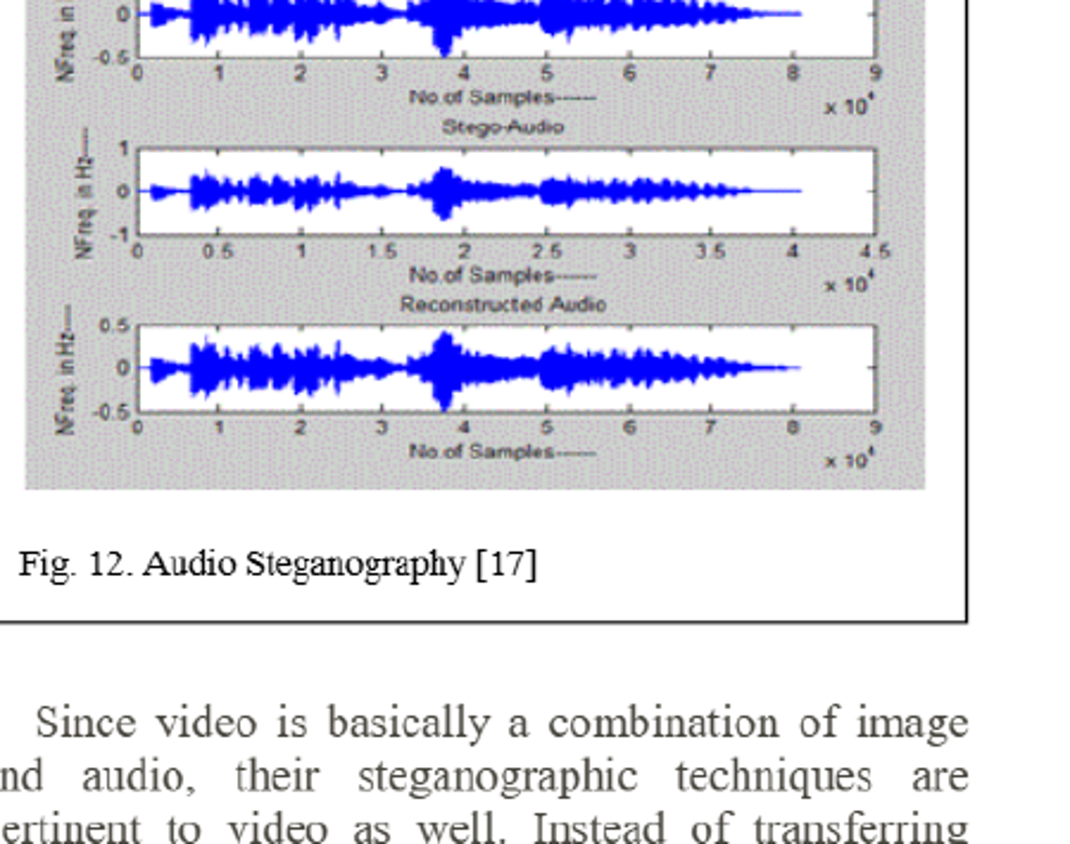
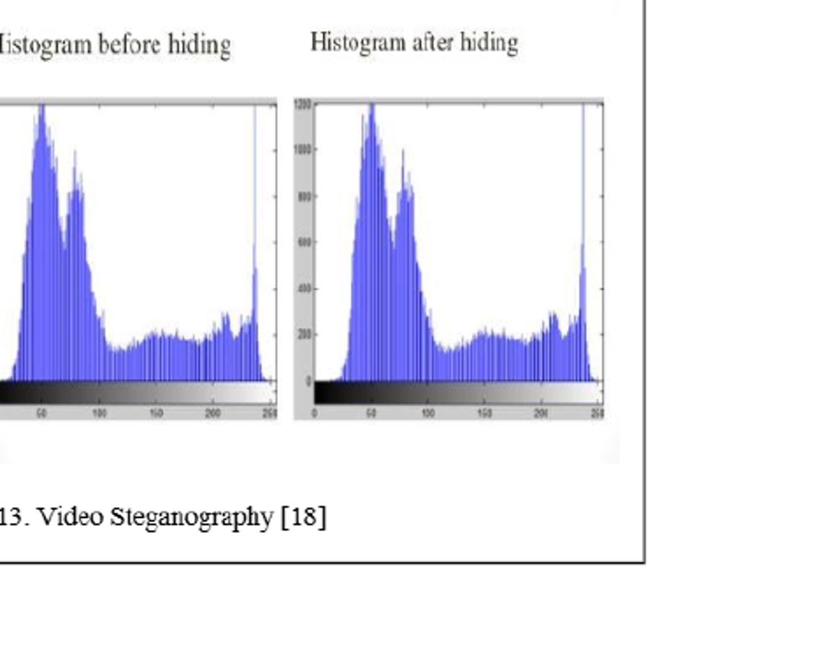
12 • MULTIMEDIA
Audio, video and protocol steganography
AUDIO
Hides secret data inside audio. The article mentions MP3 and WAV, with attributes such as sampling rate, amplification, noise, quantization, encoding/decoding, filtering and transcoding.
PROTOCOL
VIDEO
The source describes hiding information in TCP/IP packet properties and SIP/VoIP communication, where packet length or header fields become covert channels.
Video combines image and audio carriers. The source notes that more data may be embedded while distortion can remain less obvious because video is continuous.
Source: Saugata Dutta & Dr. Om Prakash, “Ancient and Modern Steganography”, Asian Journal of Convergence in Technology, Vol. II, Issue III.

Slide 14
13 • TECHNIQUES
Text steganography: lightweight but fragile
01
02
03
04
05
Character selection
HTML / tag hiding
Line & word shifting
White-space coding
Semantic / abbreviation
Choose specific characters from cover text to carry the payload.
Insert data in HTML structures that render as normal content.
Use vertical or horizontal spacing as the carrier.
Two spaces can encode one state; one space another.
Swap words for synonyms or coded abbreviations.
Source note: the article says digital-file text steganography may be less common because text often has only a small amount of redundant data.
Source: Saugata Dutta & Dr. Om Prakash, “Ancient and Modern Steganography”, Asian Journal of Convergence in Technology, Vol. II, Issue III.

Slide 15
14 • DETECTION
Steganalysis: how hidden data is detected
SOURCE DEFINITION
PRACTICAL WORKFLOW
Steganalysis is the process of detecting and retrieving secret data from a suspected stego file.
Suspect file
Feature / statistic analysis
Compare / classify
Extract or flag
Stego-Only Attack
Known Cover Attack
Known Message Attack
Chosen Stego Attack
Chosen Message Attack
The article names tools such as StegDetect, StegSecret, JPeck/JPSeek, StegBreak, Jsteg-shell, F5, appendX, Camouflage, Hiderman, JPHide and Steganography analyzer.
Why it matters: embedding quality is not enough - the stego object should avoid obvious statistical or perceptual anomalies.
Source: Saugata Dutta & Dr. Om Prakash, “Ancient and Modern Steganography”, Asian Journal of Convergence in Technology, Vol. II, Issue III.

Slide 16
15 • EVALUATION
Advantages, risks and real-world use
BENEFITS
SECURITY LENS
RISKS
Digital watermarking and copyright protection
Low-visibility communication
Can combine with cryptography
Flexible across many media types
Capacity vs. imperceptibility
Robustness vs. distortion
Detection resistance
Key management when cryptography is added
The article notes misuse in terrorism-related contexts
Hidden messages can defeat ordinary inspection
Steganalysis is needed for defensive detection
Source framing: the same concealment property that enables privacy and watermarking can also be exploited for covert or malicious communication.
Source: Saugata Dutta & Dr. Om Prakash, “Ancient and Modern Steganography”, Asian Journal of Convergence in Technology, Vol. II, Issue III.

Slide 17
16 • TAKEAWAYS
Evaluation checklist for a practical demo
1
Can the receiver recover the exact message?
Correctness
2
Can a viewer notice the carrier changed?
Perceptual quality
3
Does statistical analysis detect the change?
Steganalysis resistance
4
How much information can be embedded?
Capacity
5
Does compression / filtering break recovery?
Robustness
Good demo = hide + recover + measure
Source: Saugata Dutta & Dr. Om Prakash, “Ancient and Modern Steganography”, Asian Journal of Convergence in Technology, Vol. II, Issue III.

Slide 18
17 • CLOSE
Conclusion and references
Steganography is not a new art; the concept stays stable while the medium evolves.
Reference in the uploaded PDF
Dutta, S. & Prakash, O.
Ancient and Modern Steganography
Asian Journal of Convergence in Technology
Volume II, Issue III
ISSN No.: 2350-1146
Ancient examples hide information in objects, bodies, patterns and ordinary text.
Modern systems hide data in text, images, audio, video and network protocols.
Steganalysis is the defensive counterpoint: detect, analyze and recover hidden information.
For a technical implementation, measure correctness, perceptual quality, capacity and detectability.
Selected references listed in the article include: J. Simmons (Prisoners’ Problem), Saini & Saini, Cheddad et al., Kaur & Behal, Bassil, Kumar & Yadav, Hussain & Hussain, Sharma & Sharma, Judge, Patel & Gadhiya, Lu, plus the URLs cited as [13]-[19].
Source: Saugata Dutta & Dr. Om Prakash, “Ancient and Modern Steganography”, Asian Journal of Convergence in Technology, Vol. II, Issue III.

